Slide 1
Image Encryption
Gayathri Reddy Patlolla 20BCI0235
Sparsh Kathed 20BCI0157

Slide 2
Introduction
In the current technology-driven world, it is very essential for the users to maintain their data privacy, and to provide security and privacy, encryption decryption is a very important concept to protect user’s data from any unauthorised access. Cyber Security is essential for each individual to watch its records and advanced information to keep undesirable clients from getting to it. Image encryption is a useful technique for the protection of image content shared over internet.
Our fundamental thought process is that we will utilize a superior algorithm, that is, "Rubik's Cube algorithm" which is a picture encryption which fuses an RBG shading plan, “Hill cipher” which uses input from the user to create unique subkeys and “Affine cipher” which uses the subkeys from Hill cipher to perform various operations on the image. We have also decided to incorporate the use of MMI to further increase the security. We chose these algorithms because they are simple to grasp while still being incredibly safe. Instead of simply black and white photos, this combination of algorithms also allows us to encrypt and decrypt coloured images.

Slide 3
Algorithms Used
Hill Cipher
Affine Cipher
Rubix Cube

Slide 4
Observations from Literature survey
We referred to many research papers with different encrypting algorithms such as Steganography, chaotic based encryption and their use in generating key vector in the Rubik’s cube algorithm. Most of the methods used are quite complex and have a high time-complexity. Some of them are outdated as well, and will not survive many modern-day attacks such as brute force attacks. There aren’t many encryption algorithms or encrypting ciphers which incorporate encoding of colored images.
So, our objective is to use one of the basic encrypting algorithms i.e., Rubik’s cube algorithm and other ciphers like Hill Cipher and Affine Cipher to encrypt colour images using our knowledge of Image processing.

Slide 5
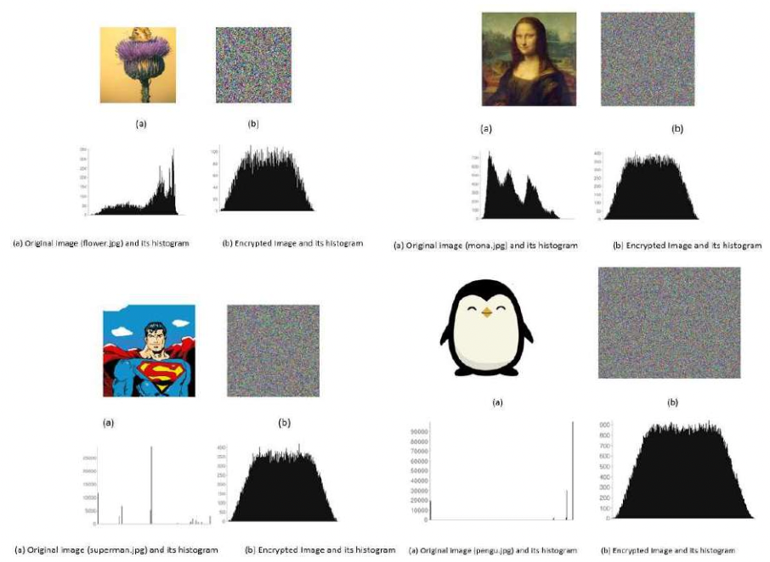
I/O

Slide 6
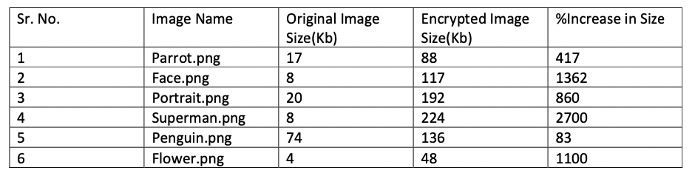
Comparison of Plain and Encrypted Image

Slide 7
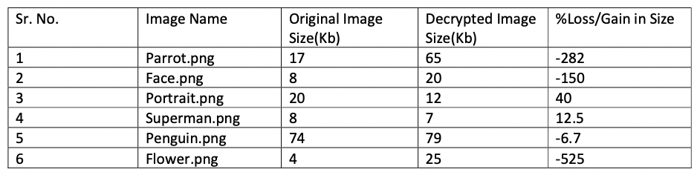
Comparison of Plain and Decrypted Image

Slide 8
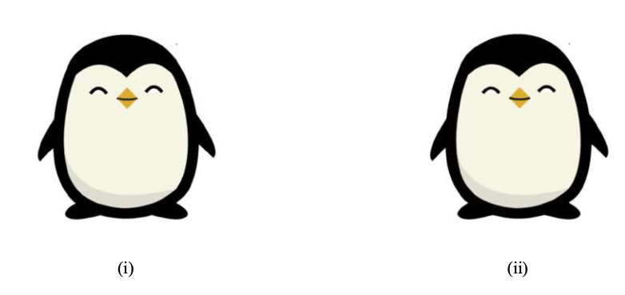
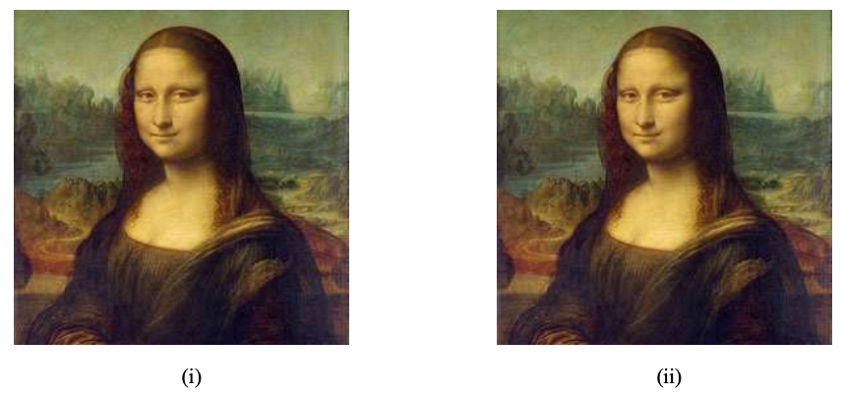
Comparison of Original Vs Decrypted Image

Slide 9
Conclusion
The Rubik's cube algorithm was used to encrypt and decrypt 2D digital images utilising an affine cypher, a circular shift of the matrix, and an XOR operation.
Experimentation findings on a variety of photos of varied sizes and extensions have proved that this new proposed system for image encryption and decryption is secure, even when the secret key is kept secret. Furthermore, the primary secret key is broken down into three sub keys, and the identical sub keys are used to encrypt the three separate panels of an RGB image. Circular shift can also be achieved by performing a secret operation on a secret key.The circular shift elements are also taken from the original secret keys. After performing an affine modification on the original, two special secret keys were constructed to be used during the XOR procedure. The cumulative effect of all of the preceding processes results in secure image encryption.

Slide 10
Future Work
With the proposed model we were able to successfully encrypt and decrypt the images, but we could not dig up the reason for significant change in the file size as well as for the little loss of quality and color. Thus for the future, we shall work on the space and quality issues. Also we look forward to reducing the time for encryption and decryption of large images (in size of mega-bytes) with securing their quality and size. We can also build this into a desktop application/mobile application/website to put it into much easier level of user communication.

